Slide 1
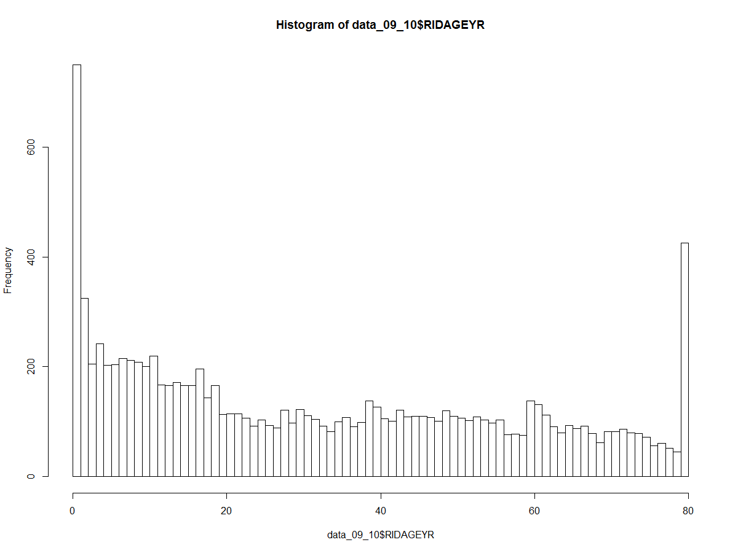
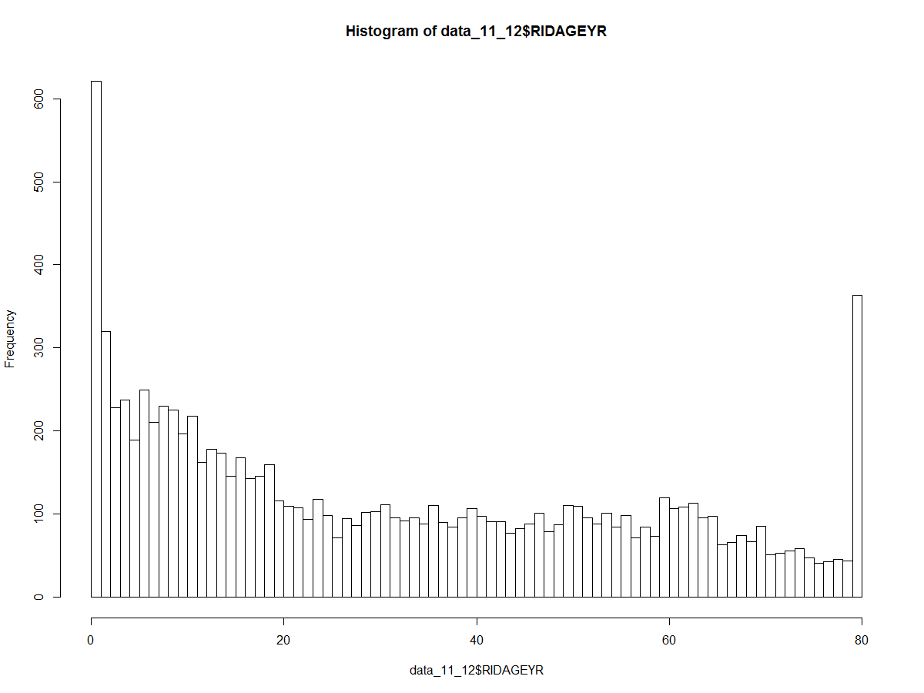
NHANES: Demographics
Age histogram for 2009-2010 and 2011-2012
n=10537
n=9756

Slide 2
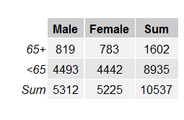

NHANES: Demographics
2009-2011
2011-2012

Slide 3


NHANES: Self-report hearing
9756 -> 9364

Slide 4
NHANES Demographics
Audiology testing between 20-69

